Slide 1

Database Architecture Final Project
Elbio Iseas
DBM/384
09/ 19/ 2016
FACULTY
Devin Dickens

Slide 2
Introduction
The purpose of the Mobile Database is to allow mobile users to access the OLTP from the mobile devices like tablets, smart phones, laptops, and any mobile computer by accessing the website.
In order to do this functionality of the system, the help of a responsive website will redirect the request when it is coming from mobile devices. It will guide to the right application by identifying the platform of the mobile device.

Slide 3
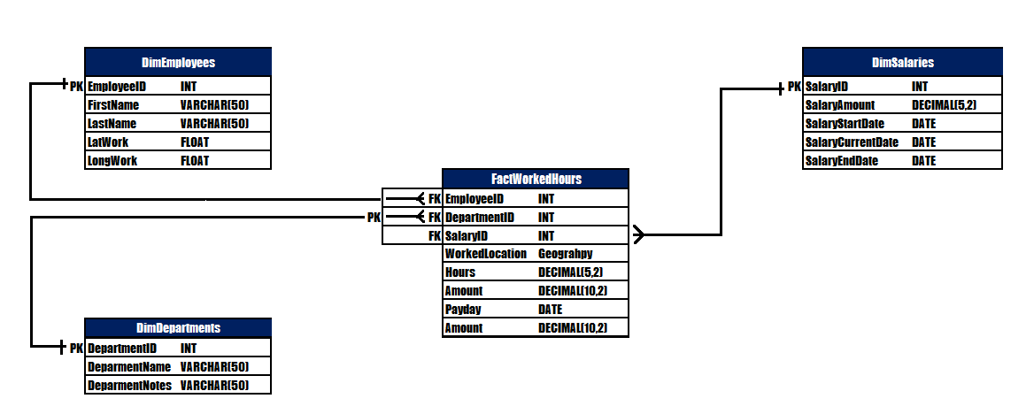
Mobile Database ERD

Slide 4
SQL scripts for the Mobile Database

Slide 5
SQL test scripts and results

Slide 6
This is the Instructor’s feedback “You show an Excel table, not a screenshot of the results of your scripts.” to week three assignment for the DDL and DMLs scripts.
This is the Instructor’s feedback “Good job, but please be more careful with the due dates.” for week four.

Slide 7
Data Migration Process Flow
The data migration process to the mobile database will be with the use of eXtensible Markup Language (XML) to SQL Server 2014.

Slide 8
Conclusion

